Slide 1
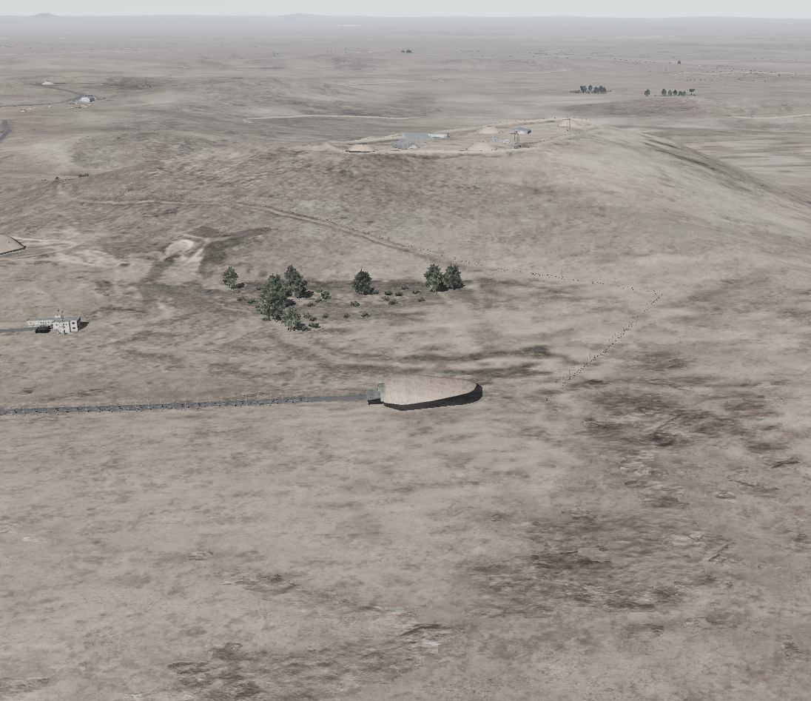

OPARTGT072 60th Air Division Headquarters
2-8
N
OPARTGT072B/C
72
1
OPARTGT072A/B – Hardened concrete bunker covered with approximately 2 meters of earth. Poured reinforced roof supported by reinforced concrete base and pillars, flat, requires delayed fuzing.
Suggested fuzing solution on DPIs 1-5– contact to penetrate earth and to open up the roof followed by delayed to pierce through floors and affect building structure and contents.
OPARTGT021C – Single hall, walls made of slabs, poured roof supported by metal frame and reinforced concrete pillars. Requires delayed fuzing.
OPARTGT072A
4
5
6
DPI 1 – Main HQ Bunker. DPI 2 – Ancilliary Bunkers. Possibility connected to Main HQ Bunker.
7
8

Slide 2
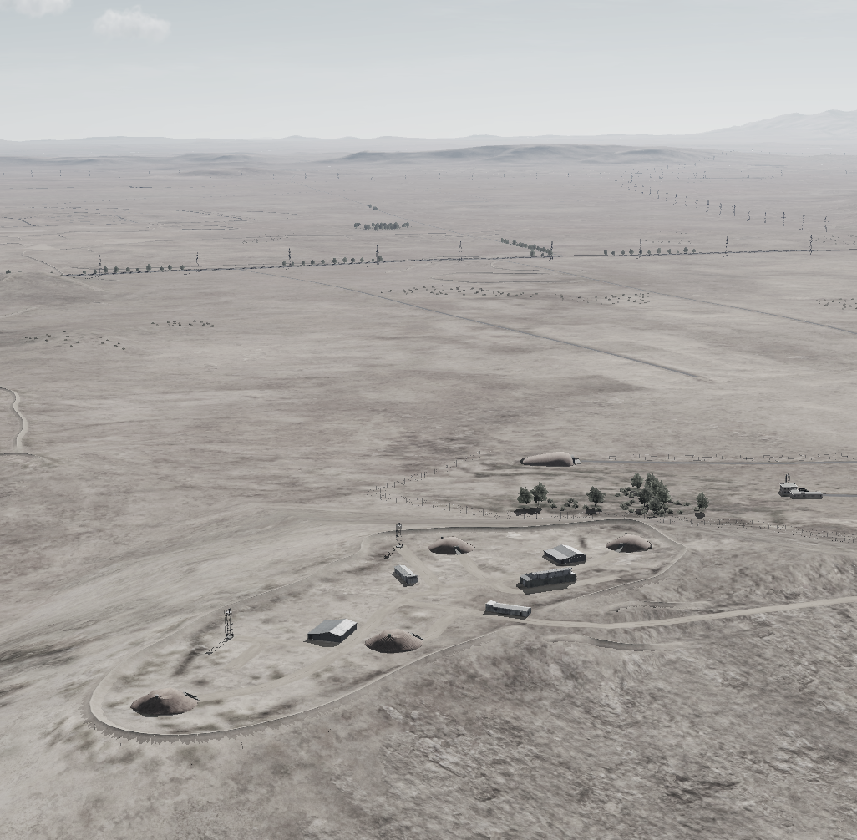
OPARTGT072 60th Air Division Headquarter DPIs
DESCRIPTION OF THE DESIRED POINTS OF IMPACT WITH WPN TYPE:
OPARTGT072A – HQ Bunker
DPI 1 N33 15.877 E036 26.367/2139ft/(2000 Ibs bomb)
OPARTGT072B – Ancillary Bunkers
DPI 2 N33 15.824 E036 26.892/2369ft/(2000 lbs bomb)
DPI 3 N33 15.871 E036 26.832/2369ft/(2000 lbs bomb)
DPI 4 N33 15.874 E036 26.723/2369ft/(2000 lbs bomb)
DPI 5 N33 15.933 E036 26.710/2369ft/(2000 lbs bomb)
OPARTGT072C – HQ Above Ground Infrastructure
DPI 6 N33 15.853 E036 26.826/2369ft/(1000 lbs bomb)
DPI 7 N33 15.908 E036 26.762/2369ft/(1000 lbs bomb)
DPI 8 N33 15.911 E036 26.730/2369ft/(1000lbs bomb)
N
OPARTGT072A
OPARTGT072C
1
4
8
5
7
6
3
2
OPARTGT072B

Slide 3
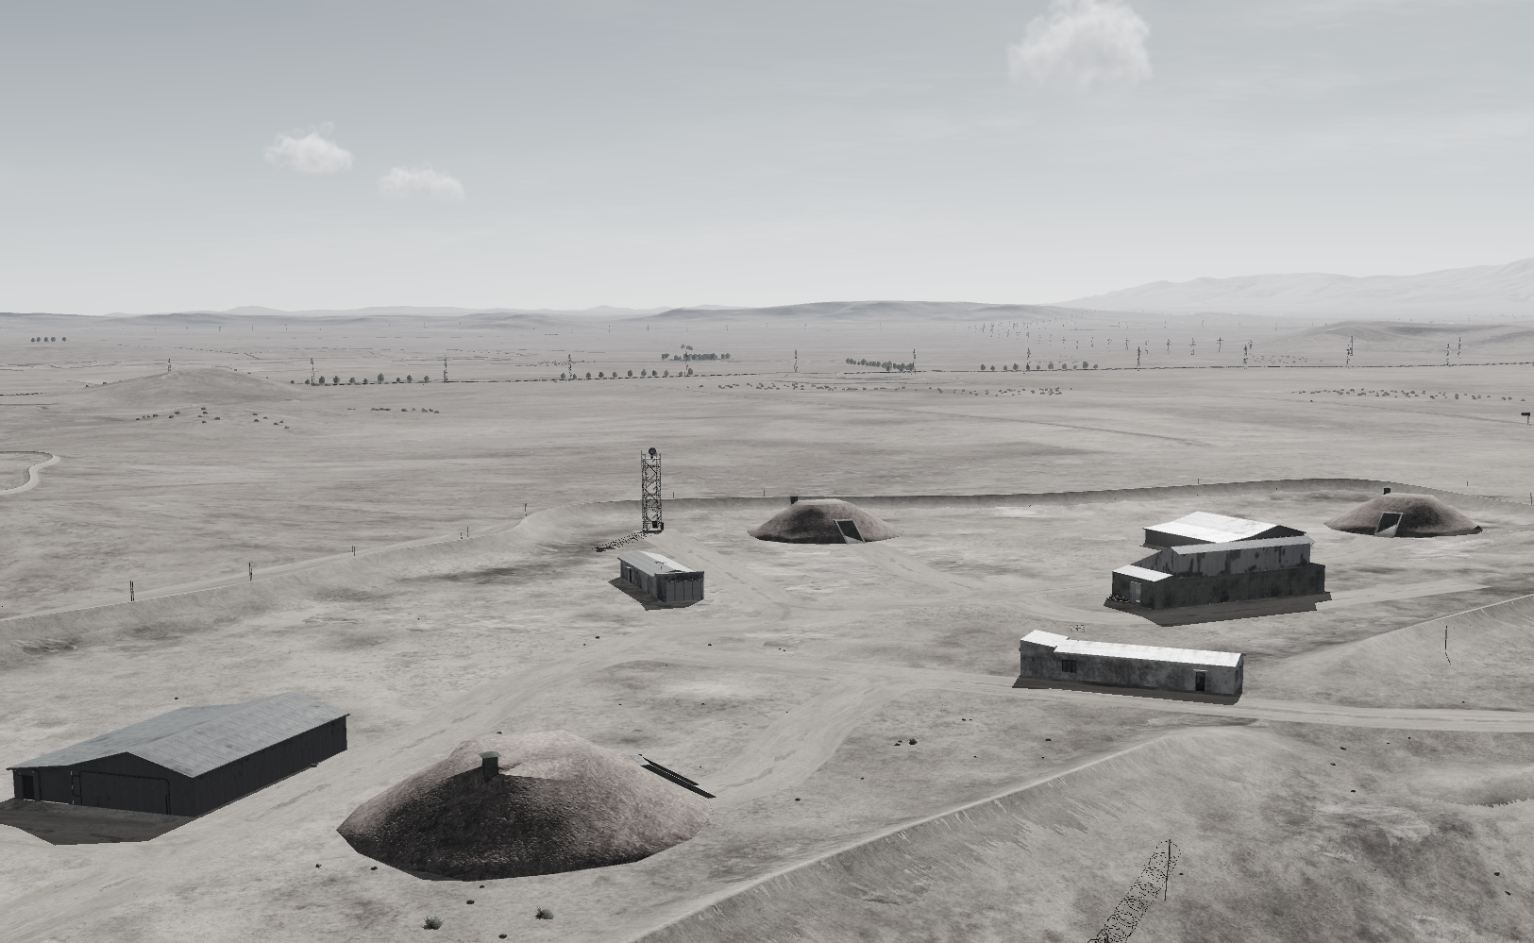
OPARTGT072 60th Air Division Headquarter DPIs
N
OPARTGT072A
OPARTGT072C
4
5
8
7
6
3
OPARTGT072B

